Slide 1
Introduction Virtualization Definition – Virtual Machine Basics – Benefits – Need For Virtualization – Limitations − Traditional Vs. Contemporary Virtualization Process – Virtual Machines – Taxonomy – Challenges
CSE4011-
MODULE 1
VIRTUALIZATION Dr.S.Anto

Slide 2
Taxonomy model -Virtualization
Five main domains in which virtualization technologies can be categorized.
Server,
Application,
Desktop,
Storage and
Network
Two new types of virtualization technologies were introduced: Management and security tools.

Slide 3
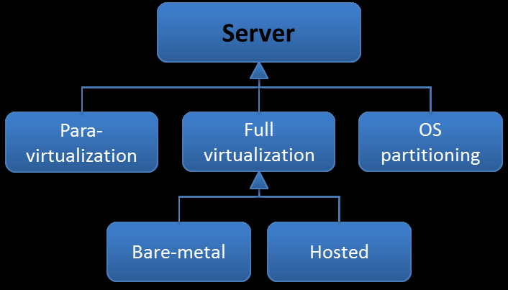
1. Server Virtualization
Server virtualization can be divided in 3 types or sub classes: Para-virtualization, full virtualization and OS partitioning.
Full virtualization technologies can be divided into two more sub classes: “Type 1” and “Type 2” hypervisors

Slide 4
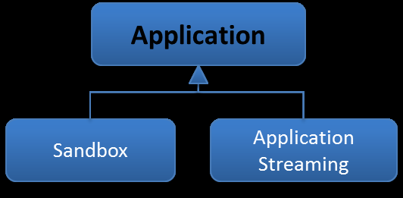
2. Application Virtualization
Two types of application virtualization technologies: sandbox and application streaming.

Slide 5
3. Desktop Virtualization
Describes two general types of desktop virtualization:
client and server.
Client desktop virtualization technologies are used to host virtual desktops (or virtual machines) locally on the clients’ computer.
Server desktop virtualization -two types: personal & shared.
Shared desktops -shared among users
Personal desktops -users having their own completely isolated desktop.
Personal desktops can further be divided into virtual or physical.
Physical desktops are equipped with additional graphic processing power for graphic intensive applications.

Slide 6
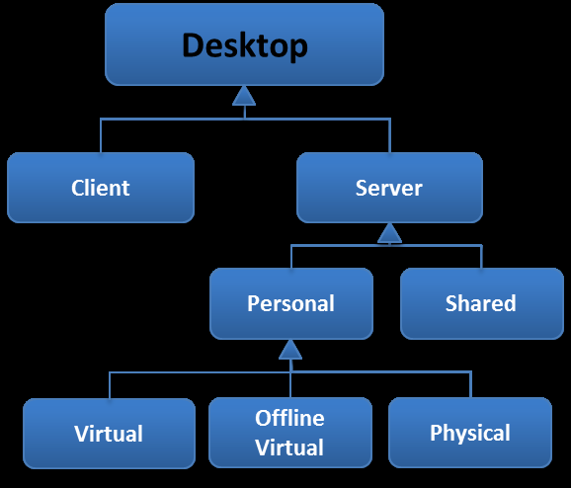
3. Desktop Virtualization

Slide 7
4. Storage Virtualization
Storage virtualization -pooling of data from multiple storage devices.
Examples of storage devices are storage attached network (SAN) and network attached storage (NAS).
While storage virtualization can be used in different or a combination of storage devices, storage virtualization can be broken up into two general classes: block virtualization and file virtualization.

Slide 8
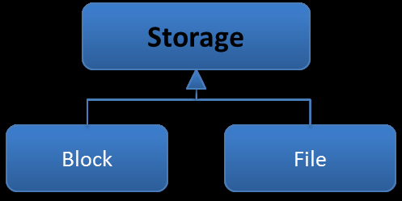
4. Storage Virtualization

Slide 9
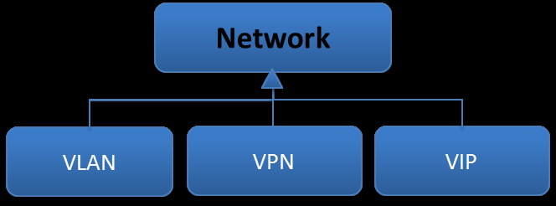
5. Network Virtualization
Network virtualization was characterized by three types of technologies:
Virtual LAN (VLAN),
Virtual IP (VIP) and
Virtual Private Network (VPN).

Slide 10
Management
The class “management” consists of a set of technologies, which can be used for management purposes.
However, management technologies for virtualization are still young and immature technologies.
In the near future more and management technologies with more features are expected.
There are currently five types of management technologies for virtualization:
Performance, Configuration, Asset, Capacity, and Cost-control.

Slide 11
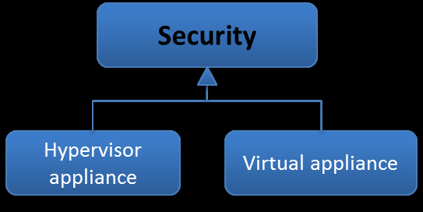
Security
Security technologies are developed specifically for virtualization.
There are two types of security tools for virtualization: virtual security appliances and hypervisor appliance.

Slide 12
Summary
The taxonomy model that is constructed above, presents an overview of all the different types of virtualization technologies.
The taxonomy model can be used for different purposes.
First of all it can be used to show what kind of virtualization technologies exist.
Secondly, the taxonomy model can be used to point out trends and in which domains new types of technologies are expected.
However, the management and security classes encompass only a set of virtualization technologies and must not be confused with other aspects of management and security, such as the making of policies and their execution.

Slide 13
Revised Taxonomy Model of Virtualization Domains
The taxonomy model lacked to illustrate the relations and dependencies between the main virtualization domains.
Also, not all virtualization domains were present in the taxonomy model.
It is better to have a layered model approach, the dependencies between the virtualization domains can be made visible.
Therefore, a revision of the taxonomy model is presented in this chapter that aims to structure the virtualization domains in a correct way.

Slide 14
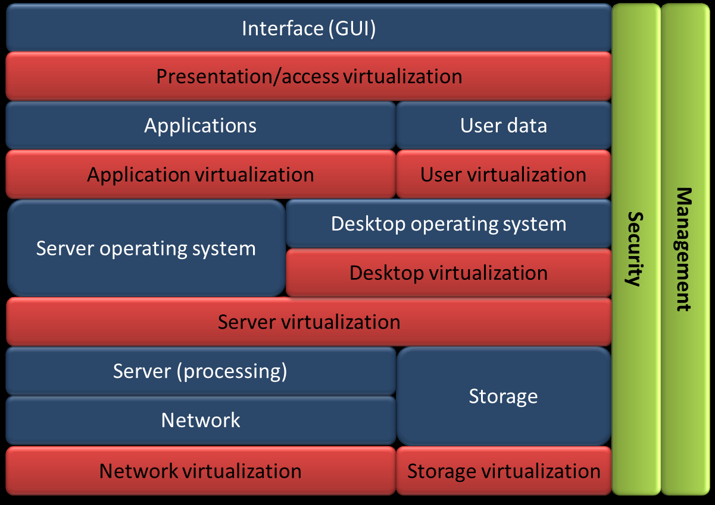
Revised Taxonomy Model

Slide 15
The blue layers
The blue layers indicate the hardware and software layers that are present in a typical server environment.
Network layer -concerned with the network requests of the upper layers and facilitates the communication from server to server or storage device, which can be located on the same private network or on a public network, such as the Internet.
It is responsible for controlling the network operations imposed by the server and operating system in the upper layers by delivering or transferring data from source to destination.

Slide 16
The blue layers
Storage layer -concerned with the storage and retrieval of data.
The storage layer is put next to the server (processing) layer as well as the network layer, because storage can be a storage device attached to the server via a network (SAN and NAS) or local storage directly attached to the server.
Server (processing) layer -concerned with carrying out the instructions of operating system layer above.
The server consists of hardware components that process the instructions imposed by the upper layers, such as a Central Processing Unit (CPU), memory, or a Network Interface Card (NIC).

Slide 17
The blue layers
Server and desktop operating system layer act as intermediaries with applications and computer hardware.
It is a software platform that manages the applications of the upper layer and handles the request of the computer programs or applications.
Regulates the ways applications communicate with computer hardware and the way users interact with the other layers in the model.
However, in a traditional server environment without virtualization, a server operates one type of operating system (OS) or instance at a time.

Slide 18
The blue layers
With virtualization, which will be explained in the red layers below, multiple instances or operating systems with their own applications can operate at the same time.
Each instance is called a virtual machine.
This way, it is also possible to host multiple virtual machines with pre-configured desktops, next to other virtual machines that host a web server or database.
These virtual machines are called virtual desktops.
Therefore, in a virtual environment multiple (desktop or server) operating systems can exist next to each another.

Slide 19
The blue layers
Application layer -concerned with requests and tasks imposed by the interface layer above.
The applications in the layer are designed to perform an activity or set of tasks that can be performed when a request or action is made in the interface layer above.
User data layer - concerned with the actions and changes made in the application layer.

Slide 20
The blue layers
In a desktop environment, users can performs tasks such as installing new applications, making or editing of documents, changing settings to their preference, etc.
These tasks produce new personal data, which are called user data.
Interface layer is the point of interaction between a user and the lower layers.
The Graphical User Interface (GUI) allows people to interact with computer programs in the layers below by offering graphical icons and elements which can be controlled.

Slide 21
The red layers
The red layers in the taxonomy illustrate the levels and layers in which the main virtualization domains relate to each other.
On the bottom, network virtualization and storage virtualization can be applied in the network layer and the storage layer.
For network and storage virtualization technologies it is not a prerequisite to have server virtualization or other types of virtualization technologies.
Server virtualization takes place above the server (processing) and storage layer and beneath the operating system layer.
This layer is also called the virtualization layer, which enables the creation of multiple isolated instances called virtual machines.

Slide 22
The red layers
Each virtual machine is equipped with their own OS and application(s), which means that multiple operating systems can operate at the same time.
Server virtualization comes also equipped with network and storage virtualization technologies.
Furthermore, with server virtualization it is also possible to create virtual desktops, which is another term for a virtual machine intended for desktop purposes.
In the same manner as virtual machines, multiple virtual desktops can be placed on a server, which means that multiple desktop operating systems can be placed on top of the server virtualization layer.

Slide 23
The red layers
Desktop virtualization is placed directly on top of the server virtualization layer.
A virtual desktop is a virtual machine.
Depending on the type of desktop virtualization technology, virtual desktops can be made for each user or a (shared) virtual desktop for a group of users.
Application virtualization takes place above the operating system layer and allows for the decoupling of the applications layer from the operating system layer.
This way, applications can be isolated from the OS and can be executed without installation on the OS.

Slide 24
The red layers
Application virtualization technologies have been used without other virtualization domains, such as server virtualization and desktop virtualization.
However, full application virtualization requires presence of a virtualization layer or server virtualization.
Full application virtualization means using the full palette of application virtualization technologies, where applications are streamed or executed from a central location.
This way, applications can be updated or changed from one point in a central location.

Slide 25
The red layers
User virtualization, also known as user state or profile virtualization creates an abstraction layer between user data by separating user data, such as profile settings, user application data and storage data from OS and application.
The user data is now stored separately from the application or OS and not interwoven.
Presentation or also called access virtualization creates an abstraction layer between user interface and the other layers below, which allows to user to access and control the other layers remotely.
The General User Interface (GUI) is streamed towards the device. User virtualization and presentation or access virtualization are both virtualization domains that in particular are used in combination with desktop virtualization.

Slide 26
The green layers
The green layers show the relation between the management and security domain with the other main virtualization domains.
Both management and security tools are also seen as types of virtualization technologies, because with virtualization new security and management issues have been addressed.
This has led to the development of new management and security tools for virtual environments.
Management and security tools have a relation with each of the other layers and have a supporting function.
For each particular layer, management and security tools can be used to provide management or security measures.

Slide 27
THANK YOU

